Slide 1
Nafion SCFT Update
10/01/2024

Slide 2
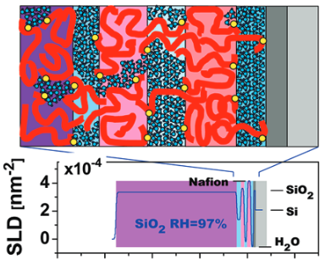
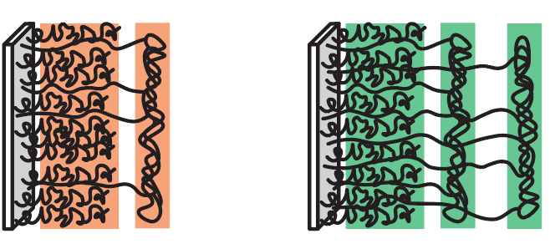
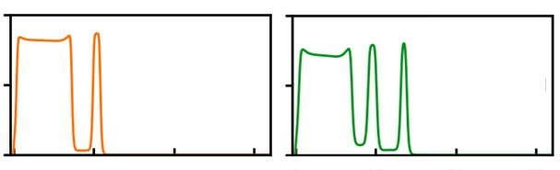
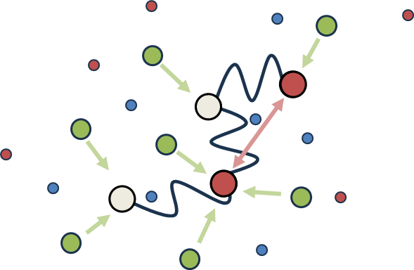
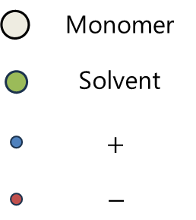
Last time: Motivation
Polymer morphology is important (but complicated) in nafion membranes
Experiment
Theory
Self-consistent field theory (SCFT) can provide nafion microstructure under coupled physics
Elasticity vs. charge vs. hydrophobicity

Slide 3
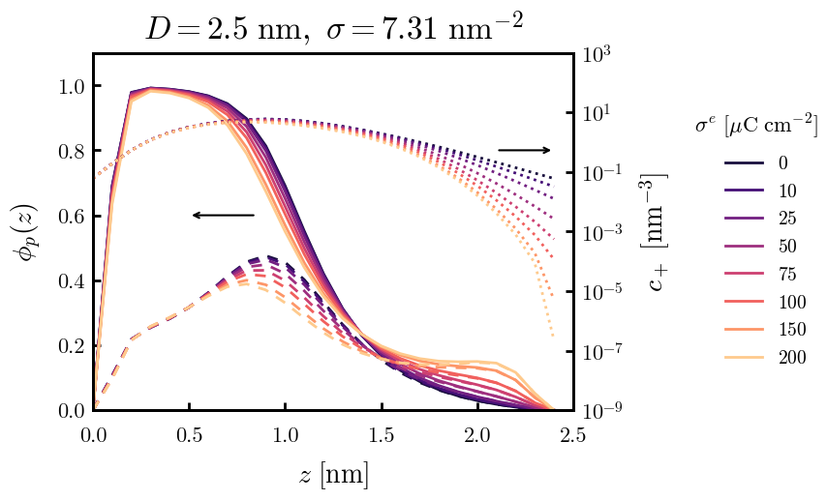
Last time: Model
Polymer: Nafion sidechains only
Solvent: Explicit, water
Ions: Salt solution
Charge: Surface, sidechain sulfonates (−), salt cation (+), salt anion (−)

Slide 5
Supplemental Slides

Slide 6
test

